Slide 1
CHINOOK MUSIC STORE ANALYSIS
BY
SHRISHTI SHRIVASTAVA

Slide 2
AGENDA
Problem Statement
Data Description
Objective Key Metrics and Visualizations
Subjective Question for Insights

Slide 3
PROBLEM STATEMENT
Chinook seeks to gain insights into customer purchasing behavior and market dynamics in the music industry.
By analyzing sales data, the company aims to identify top-selling tracks and artists, understand customer demographics, and assess purchasing trends across different genres and geographic locations.
This analysis will facilitate targeted marketing strategies, enhance customer retention efforts, and inform promotional initiatives for new record label albums based on genre performance and regional preferences.
Additionally, Chinook aims to develop risk profiles for customer segments to better predict churn and improve customer lifetime value modeling.

Slide 4

DATA OVERVIEW
The dataset consists of 11 tables, containing various data related to Chinook Music Services.
The company has a customer base spread across 24 different countries worldwide. The tracks sold encompass 25 diverse genres, including Rock, Metal, Jazz, and more.
Additionally, the dataset includes information about the albums and artists associated with each track.
The invoice table records all transactions within the company, providing detailed data on sales activities.

Slide 5
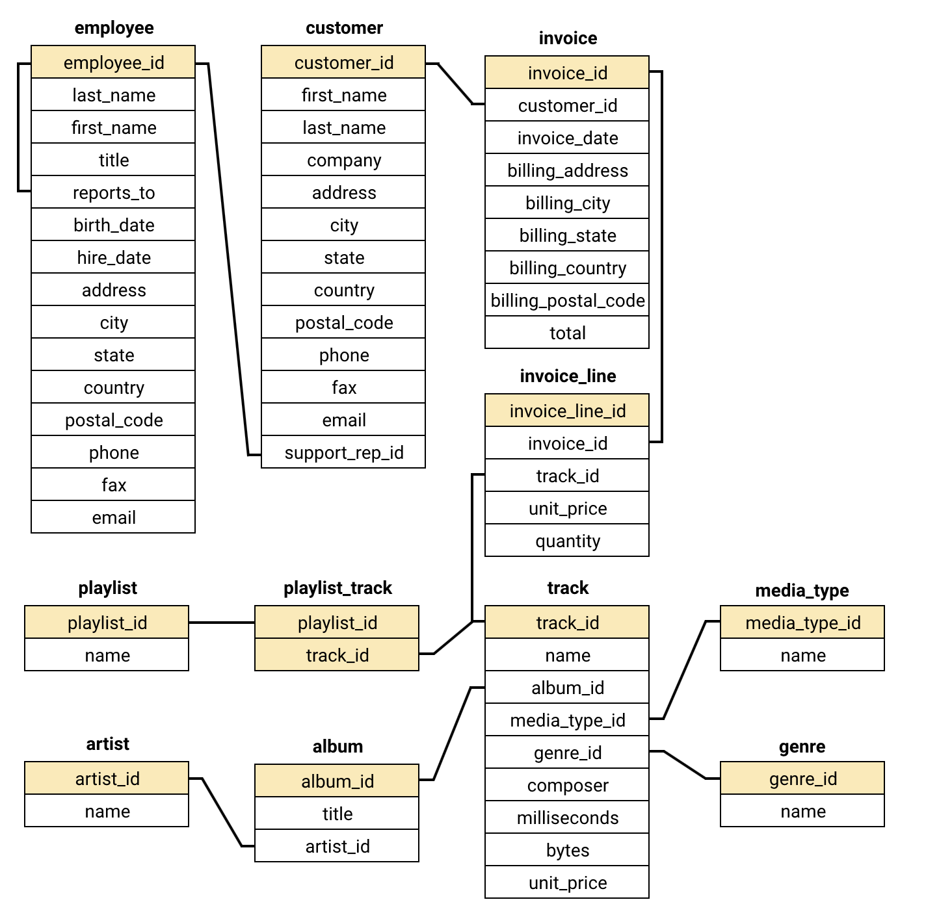
DATABASE SCHEMA

Slide 6
DATA DESCRIPTION
customer:
customer_id: Unique identifier assigned to each customer.
first_name: The given name or first name of a customer.
last_name: The surname or family name of a customer.
company: The name of the company associated with a customer.
address: The street address of a customer's location.
city: The city where a customer is located.
state: The state or province where a customer is located.
country: The country where a customer is located.
postal_code: The postal or zip code of a customer's address.
phone: The phone number of a customer.
fax: The fax number associated with a customer.
email: The email address of a customer.
support_rep_id: The employee ID of the support representative assigned to a customer.
invoice_line:
invoice_line_id: Unique identifier assigned to each line item on an invoice.
invoice_id: The invoice ID to which the line item belongs.
track_id: The ID of the track or product included in the line item.
unit_price: The price per unit for the line item.
quantity: The quantity of units for the line item.

Slide 7
DATA DESCRIPTION
invoice:
invoice_id: Unique identifier assigned to each invoice.
customer_id: The customer ID associated with the invoice.
invoice_date: The date when the invoice was generated or issued.
billing_address: The street address used for billing purposes.
billing_city: The city used for billing purposes.
billing_state: The state or province used for billing purposes.
billing_country: The country used for billing purposes.
billing_postal_code: The postal or zip code used for billing purposes.
total: The total amount due on the invoice.
playlist:
playlist_id: Unique identifier assigned to each playlist.
name: The name or title of the playlist.
playlist_track:
playlist_id: The ID of the playlist to which the track belongs.
track_id: The ID of the track included in the playlist.
genre:
genre_id: Unique identifier assigned to each genre.
name: The name or description of the genre (e.g., rock, pop, classical).

Slide 8
DATA DESCRIPTION
track:
track_id: Unique identifier assigned to each track or song.
name: The title or name of the track.
album_id: The ID of the album to which the track belongs.
media_type_id: The ID of the media type associated with the track.
genre_id: The ID of the genre associated with the track.
composer: The name of the composer or artist who composed the track.
milliseconds: The duration of the track in milliseconds.
bytes: The file size of the track in bytes.
unit_price: The price per unit for the track.
album:
album_id: Unique identifier assigned to each album.
title: The title or name of the album.
artist_id: The ID of the artist associated with the album.
artist:
artist_id: Unique identifier assigned to each artist.
name: The name of the artist.
media_type:
media_type_id: Unique identifier assigned to each media type.
name: The name or description of the media type (e.g., MPEG audio file, AAC audio file).

Slide 9

METHODOLOGY
Step 4
Advanced Queries: Uncovering Insights
Used advanced queries to find hidden patterns (e.g., churn rate, customer segmentation).
Gained valuable business insights.
Step 1
Database Schema: The Blueprint:
We Understood the database structure (tables, relationships).
Essential for efficient data navigation.
Step 3
Data Cleaning: Ensuring Accuracy
Cleaned and prepped data (e.g., handled missing values with coalesce).
Ensured reliable analysis.
Step 2
Basic Queries: First Look
Used simple queries to explore the data.
Identified key areas for deeper analysis.

Slide 10
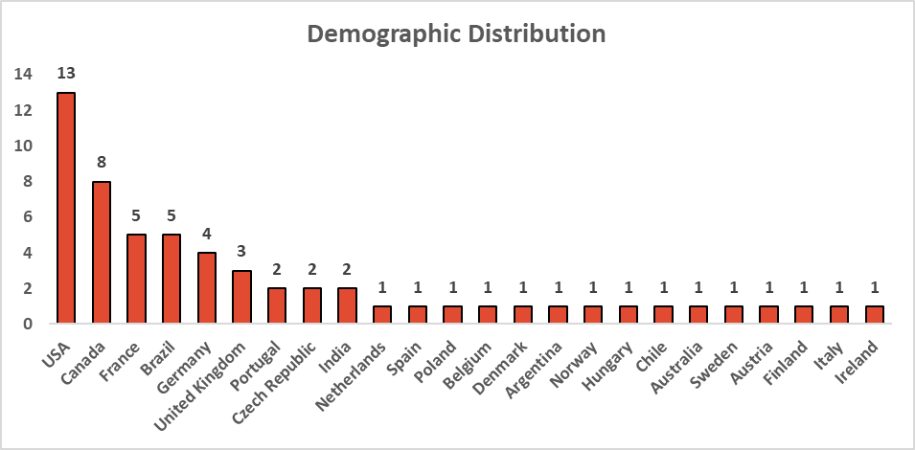
DEMOGRAPHIC ANALYSIS
This slide provides an overview of the customers distributed across different geographic locations.
USA has the highest number of customers in the list followed by Canada, France, Brazil and Germany.
Other countries like Portugal, India, Spain, Belgium, Argentina, Norway etc. have 1 or 2 customers.

Slide 11
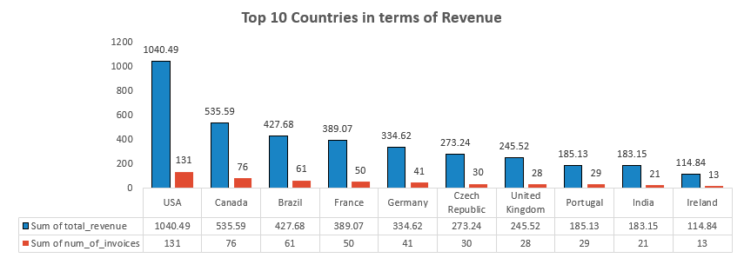
REVENUE ACROSS COUNTRIES
The bar chart shows us the revenue based on the track sales in all the countries.
For better visualization, we have considered the top 10 countries in terms of revenue.
The highest sale is in USA with an amount of 1040.49 and 131 purchases, followed by Canada and Brazil in the 2nd and 3rd places respectively.
This visualization helps us to focus on the sales based on the geographic location.

Slide 12
CUSTOMER PURCHASING BEHAVIOUR
Key Takeaways: -
Long-term customers are better in all aspects(frequency, basket size, and total spending).
It shows that customer loyalty plays an important role in increasing a company's revenue because long-term customers tend to buy more than short-term customers.
Therefore, the company should focus on the retention rate of the customers to increase sales over time.

Slide 13
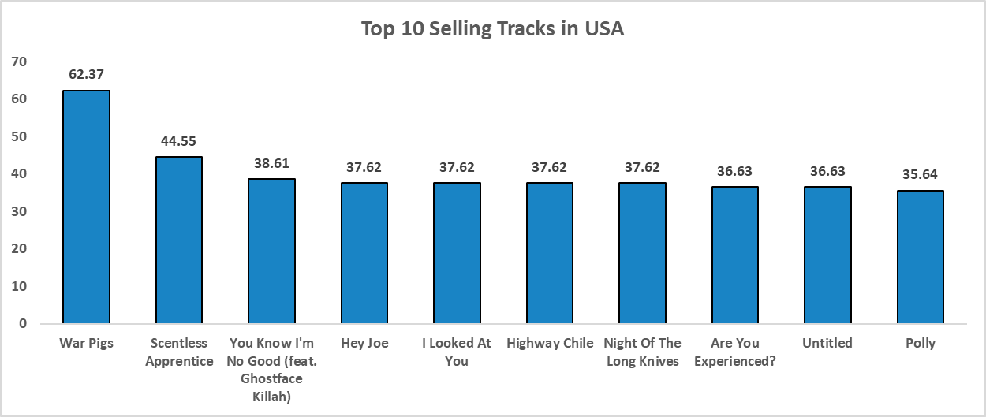
TOP-SELLING TRACKS (USA)
The visual displays the top 10 selling tracks in USA which conveys the following:
War Pigs is the highest selling track in USA generating a revenue of 62.37 followed by Scentless Apprentice with a revenue of 44.55.
More customers have purchased the track named War Pigs comes to the track named Scentless Appearance.
This information helps in understanding the customer preferences of the tracks based on the purchase.

Slide 14
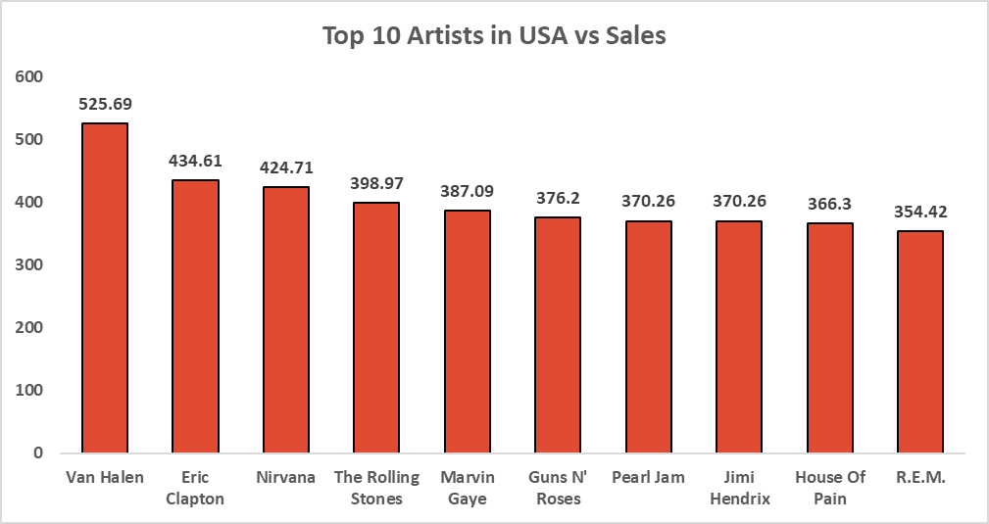
TOP -SELLING ARTISTS (USA)
The visual depicts the top selling artists in USA from the given data. We can infer the following from the visual as follows:
Van Helen is the top selling artist in USA with a revenue of 525.69 followed by Eric Clapton.
This data can help us identify the top artists related to the tracks and genre and also recommend them to the customers who have similar preferences.

Slide 15
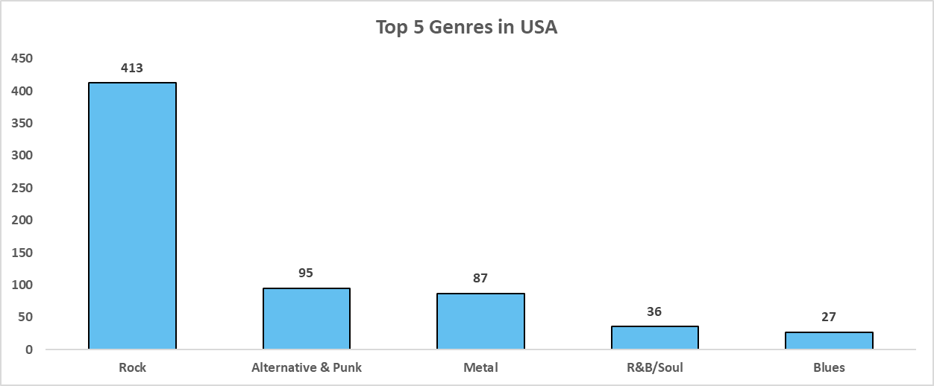
FAMOUS GENRES (USA)
We can observe the top 5 genres in USA with respect to the number of tracks sold.
The Rock genre has the most number of tracks sold (413), followed by Alternative & Punk and Metal.
This visual helps us to understand the customer’s preferences on genres with which we can recommend similar genres to the customer for future purchases.

Slide 16
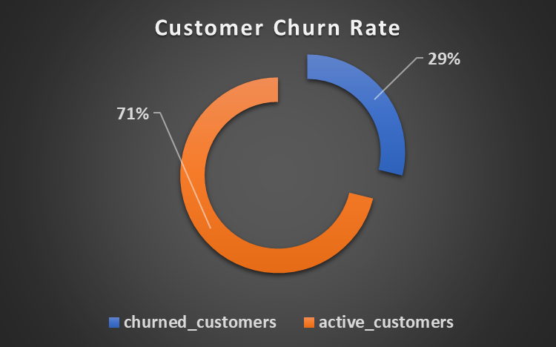
CUSTOMER CHURN RATE
A customer is considered to be a churned customer if they have not made any purchase in the last 6 months.
Total Number of customers = 59
Churned customers = 17
Customer Churn Rate = 17 / 59 = 29%
The customer churn rate implies that almost 2 in every 7 customers are inactive or churned.

Slide 17
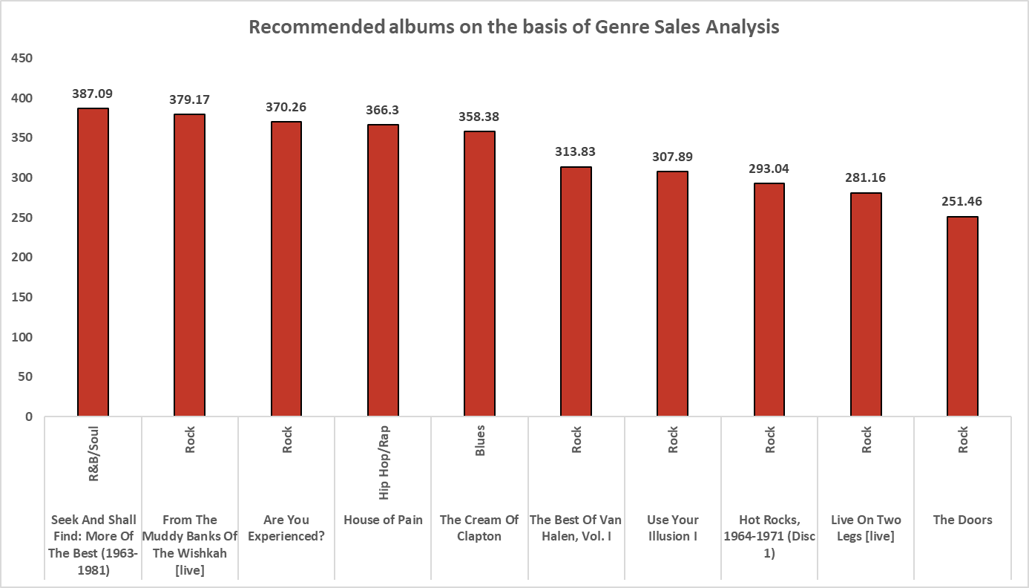
Key Takeaways : Based on the Genre Sales Analysis, the following 3 albums can be prioritised for advertising and promotion in USA: Rock: The list is dominated by rock albums, which have many entries and strong sales. This indicates a large and devoted following, most likely as a result of the genre's enduring appeal in American society. R&B / Soul: Strong cultural significance may be the reason for this genre's great sales, as evidenced by the top album, particularly in areas with deep historical connections to the growth of R&B and Soul.
RECOMMENDATIONS BASED ON GENRE SALES ANALYSIS(USA)

Slide 18
RECOMMEND-ATIONS BASED ON GENRE SALES ANALYSIS(USA)
3. Hip Hop / Rap or Blues:
The genres of hip hop, rap, and blues have devoted but specialized fan bases.
1. Hip Hop/Rap is especially popular among younger audiences and urban areas, where the genre often addresses themes relevant to modern life and youth culture.
2. Blues, on the other hand, appeals to audiences interested in traditional American music roots, particularly in regions with historic ties to the genre.
Hence, the three albums recommended based on the Genre Sales Analysis are [Rock], [R&B/Soul], [Hip Hop/Rap or Blues].

Slide 19
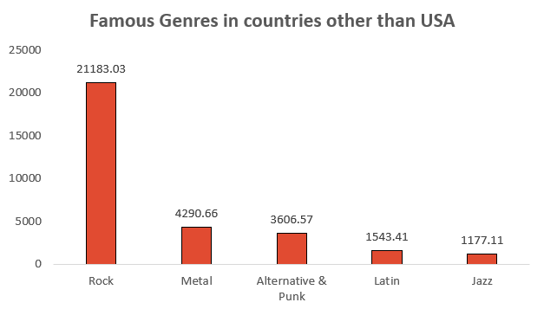
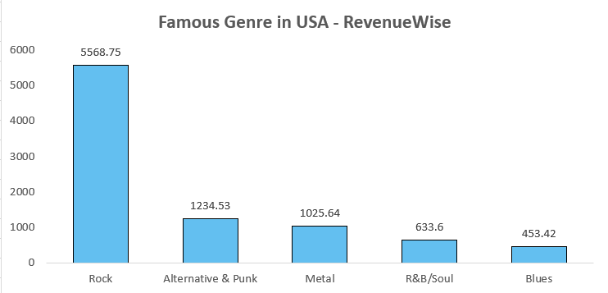
FAMOUS GENERES COMPARISON
We can observe some similarities in terms of famous genres in countries other than USA vs USA.
In both the cases, we can observe that Rock is the most famous Genre. The 2nd and 3rd places are interchanged in case of countries other than USA. Metal is the second popular genre in countries other than USA, followed by Alternative & Punk.

Slide 20
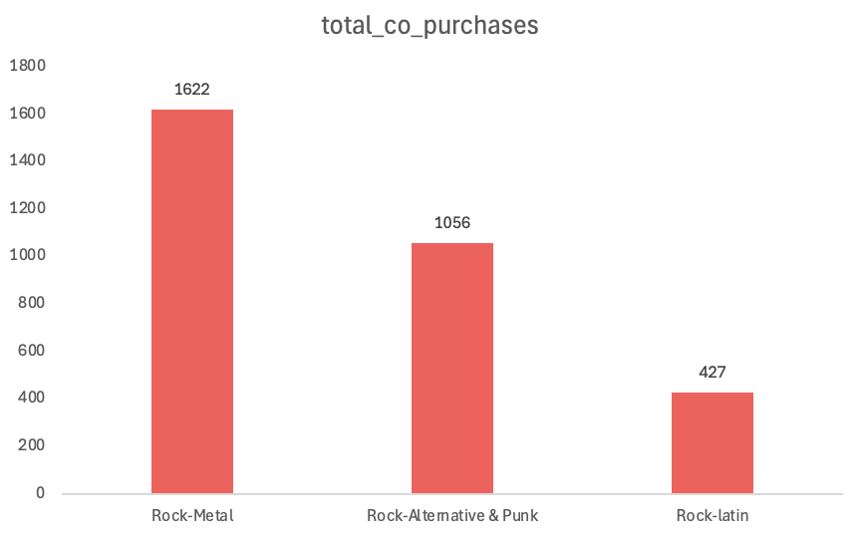
PRODUCT AFFINITY ANALYSIS (Genres frequently purchased together)
Rock frequently combines with genres like Metal, Alternative & Punk, and Latin.
Rock's versatility appeals to customers with diverse music preferences.
Metal customers often purchase Rock, presenting opportunities for cross-promotion.
A strong affinity exists between Alternative & Punk and Rock, highlighting crossover interest.
Co-purchasing trends between Latin music and Rock reveal significant opportunities.
Recommending Latin music to Rock fans can leverage varied customer tastes.

Slide 21
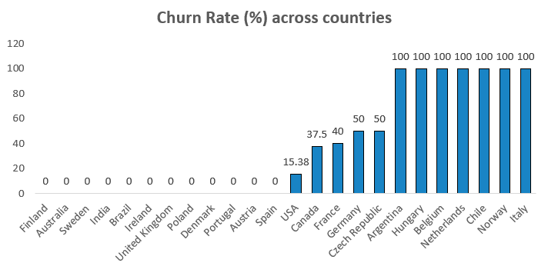
RISK PROFILING
By calculating churn rates by country, we can determine if certain geographical segments show consistently high churn. These rates could indicate potential service, product, or market fit issues within specific locations.
Additionally, high-volume spenders who show purchase frequency drops could signify declining interest, indicating an at-risk, high-value customer.

Slide 22
RISK PROFILING
Customers with low purchase frequency (like the 180-day interval in this analysis) are at higher risk of churn. These customers may only respond to specific promotional periods or are less invested in the brand’s products.
For high-churn countries, consider deploying localized marketing campaigns and enhancing service offerings to improve customer satisfaction.

Slide 23
Are You Experienced?
Genre: Rock
Reason for Promotion: Rock is a top-performing genre in the USA, and this album stands out in the market. Targeting this strong segment is likely to yield high returns.
Get Born
Genre: Alternative & Punk
Reason for Promotion: With growing popularity, this genre appeals to contemporary music fans. The album’s strong sales momentum makes it an ideal candidate for promotion.
The Doors
Genre: Rock
Reason for Promotion: As a classic rock favorite with historical significance, this album appeals to both nostalgic fans and new listeners, reinforcing the label’s market position.
RECOMMENDE-D ALBUMS FOR PROMOTION (IN USA)

Slide 24

STRATERGY RECOMMENDATIONS
Prioritize High-Performing Genres
Rock and Alternative & Punk: Focus promotions on these top-selling genres, particularly in the USA, to capitalize on their established demand.
Region-Specific Strategies
USA: Highlight Rock and Alternative album promotions.
International Markets: Boost sales by promoting Metal and Rock in regions with strong co-purchase patterns.
Cross-Selling Opportunities
Co-Purchased Genres: Bundle Rock and Alternative & Punk albums with Metal to leverage frequent co-purchase trends.
Artist Synergy: Promote bundles featuring artists like Led Zeppelin, Green Day, and Foo Fighters to maximize sales.
Focus on Long-Term Customers
Loyalty Programs: Reward loyal customers with exclusive releases or benefits to maintain engagement.
Churn Prevention: Re-engage inactive customers through targeted emails and limited-time offers.

Slide 25
CONCLUSION
Focused Genre Promotion
Emphasize high-performing genres like Rock and Alternative & Punk, especially in the USA, to maximize sales through targeted album promotions.
Cross-Selling Opportunities
Boost revenue by leveraging product affinity and cross-selling frequently co-purchased genres, artists, and albums.
Region-Specific Targeting
Tailor strategies by focusing on Rock and Alternative in the USA, while promoting Metal and Rock in international markets.
Customer Retention
Enhance lifetime value by preventing churn among long-term customers through targeted campaigns and personalized offers.
Final Takeaway By promoting top genres, capitalizing on cross-selling, and prioritizing customer retention, the company can strengthen its market position and drive sustained growth.

Slide 26
CONCLUSION
THANK YOU

